Slide 1
VoLTE Basics and Call Flow

Slide 2
VOIP and VoLTE
VoIP is the generic term: anything carried over IP packets can count, including Skype, Facetime or other services.
Packets are packets and the only thing that knows they are voice is the application that receives than & processes them eg your Skype app.
VoLTE is a specific type of VoIP designed into the LTE standard, so it has lots of very specific optimizations and accelerations.
In effect, the packets are treated as "special" by the whole LTE network.
That means it will work better (lower latency, less power, etc) - and as you say, be able to handover to other LTE cells or to 3G/2G legacy networks.
VoLTE call quality greatly exceeded that of 3G CS voice and was measurable higher than the HD voice service offered by Skype
With network loading, and in particular with background applications running on the mobile phone and transferring data with the network, the VoLTE results were considerably better than Skype
VoLTE call setup time was nearly twice as fast as 3G Circuit Switched Fallback (CSFB) call setup
VoLTE used substantially fewer network resources than Skype voice, which in turn resulted in longer estimated device battery life for the subscriber and a more efficient network for the operator
When leaving LTE coverage, VoLTE calls were successfully handed over to 3G CS voice. The network’s enhanced Single Radio Voice Call Continuity ensures calls continue without interruption

Slide 3
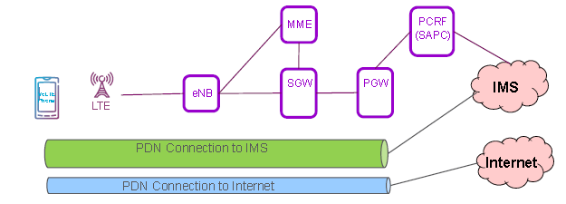
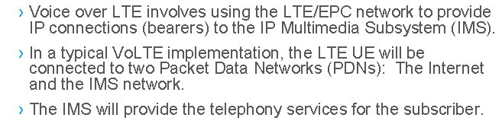
What is VoLTE

Slide 4
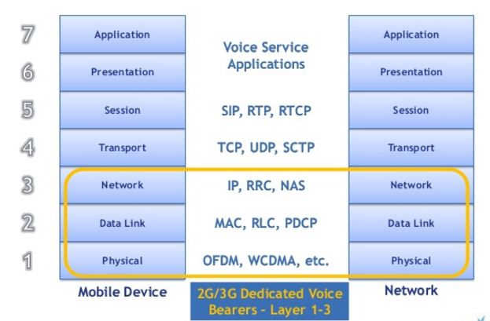
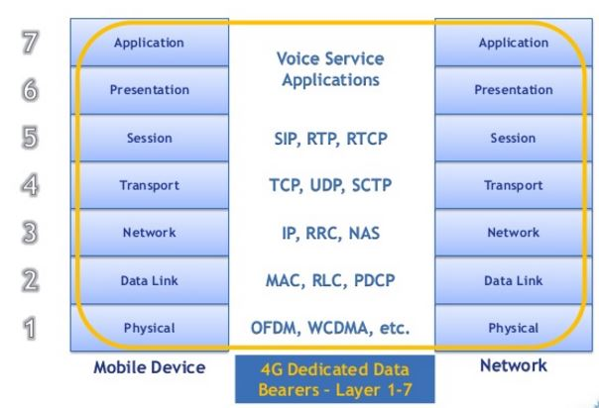
Layers

Slide 5
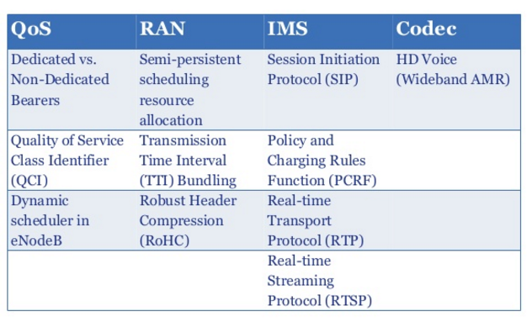
Basic of VoLTE

Slide 6
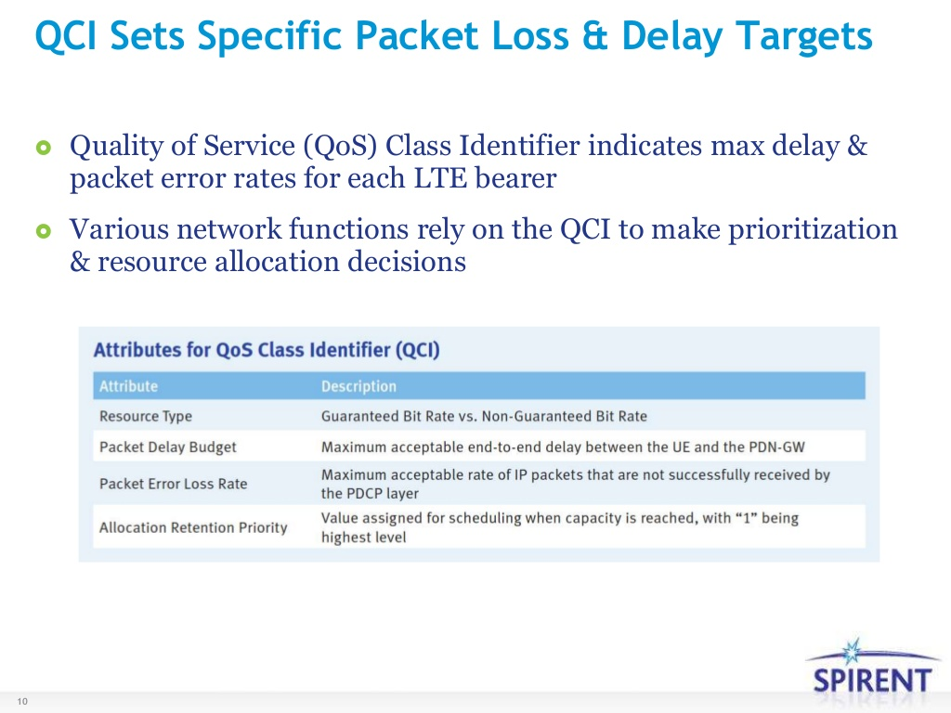

Slide 7
IMS Registration – SIP (Session Initiation Protocol) Registration
UE
eNodeB
MME
SGW
PGW
PCRF
HSS
P-CSCF
I-CSCF
S-CSCF
TAS
Default Bearer Established for IMS signaling
IMS Signaling Over IP
SIP Register
Sip register
User-Authorization-Request
User-Authorization-Answer
Multimedia-Auth-Request
Sip register
Multimedia-Auth-Answer
401- Unauthorized
401- Unauthorized
401- Unauthorized
SIP Register
Sip register
User-Authorization-Request
User-Authorization-Answer
Server-Assignment-Request
Sip register
Server-Assignment-Answer
200 - OK
200- OK
200- OK
authentication and/or authorization Request
authentication and/or authorization Answer
Sip register
User Data Request
User Data Answer
SIP Subscribe
200- OK
200 Ok (Subscribe)
SIP Subscribe
SIP Subscribe
200 Ok (Subscribe)
200 Ok (Subscribe)
SIP Subscribe
Sip Notify
200 Ok (Notify)
200 Ok (Subscribe)
Sip Notify
Sip Notify
SIP Notify
200 Ok (Notify)
200 Ok (Notify)
200- OK (Notify)

Slide 8
IMS Registration – Default Bearer Creation
UE
eNodeB
MME
SGW
PGW
PCRF
Policy and Charging Rules Function
HSS
Home subs. server
P-CSCF
I-CSCF
S-CSCF
TAS Telecom Application Server
RRC Conn req
RRC Conn Setup
Attach Req
RRC Connection Setup complete
[ Dedicated NAS ]
[ PDN Connectivity Request]
Attach Req
NAS PDU
EPS SM: PDN Connectivity Request
Authentication/Security
Update Location Request
Update Location Answer
Create Session req
IMS-APN; QCI:5; ARP; APN AMBR
Create Session req
IMS-APN; QCI:5; ARP; APN AMBR
Credit Control Request
Create Session Response
Create Session Response
Credit Control Answer
E-RAB Setup Request
QCI:5; ARP; UE AMBR Setup
IP default rule TFT
RRC Conn recong
NAS PDU
Activate Default Bearer Request
NAS PDU
Activate Default Bearer Request
RRC Conn reconf. Comp
E-RAB Setup Response
UL Data Transfer
Attach Complete
Modify Bearer Request
Modify Bearer response
Default Bearer Established for IMS signaling
IMS Signaling Over IP

Slide 9
UE Registers With IMS Network
IMS
UE
eNB
MME
SGW
PGW
PCRF
CSCF
SBG
Session Border Gateway
IMS PDN Connection
Default Bearer QCI = 5. IMS Signaling.
SIP Register
SIP Register
401 Unauthorized (nonce)
401 Unauthorized (nonce)
SIP Register (with Auth Info)
SIP Register (With Auth Info)
200 OK
200 OK

Slide 10
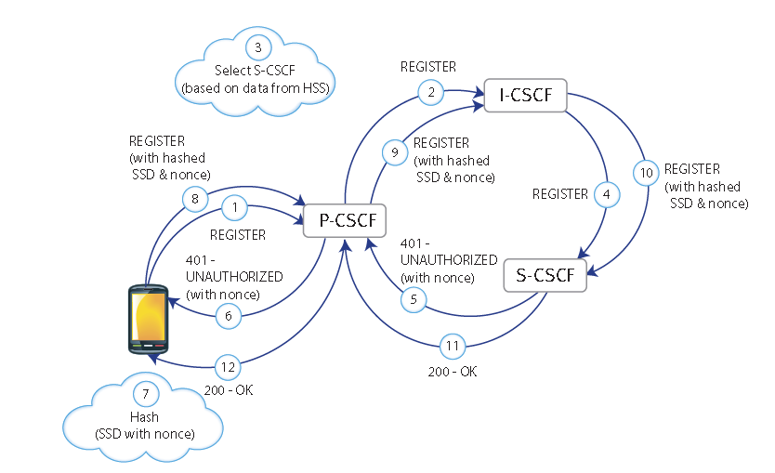
Call Session Control Function
Proxy/Serving/ Interrogating
Home Subscriber Server
1.The IMS client attempts to register by sending a REGISTER request to the P-CSCF.
2. The P-CSCF forwards the REGISTER request to the I-CSCF.
3. The I-CSCF polls the HSS for data used to decide which S-CSCF should manage the REGISTER request. The I-CSCF then makes that decision.
4. The I-CSCF forwards the REGISTER request to the appropriate S-CSCF.
5. The S-CSCF typically sends the P-CSCF a 401 (UNAUTHORIZED) response as well as a challenge string in the form of a “number used once” or “nonce”.
6. The P-CSCF forwards the 401 – UNAUTHORIZED response to the UE.
7. Both the UE and the network have stored some Shared Secret Data (SSD), the UE in its ISIM or USIM and the network on the HSS. The UE uses an algorithm to hash the SSD and the nonce.”
8. The UE sends a REGISTER request to the P-CSCF. This time the request includes the result of the hashed nonce and SSD.
9. The P-CSCF forwards the new REGISTER request to the I-CSCF.
10. The I-CSCF forwards the new REGISTER request to the S-CSCF.
11. The S-CSCF polls the HSS (via the I-CSCF) for the SSD, hashes it against the nonce and determines whether the UE should be allowed to register. Assuming the hashed values match, the S-CSCF sends 200 – OK response to the P-CSCF. At this point an IPSec security association is established by the P-CSCF.
12. The P-CSCF forwards the 200 – OK response to the UE.
The UE initiates the registration sequence, attaches to the LTE network and activates the PDP context. It discovers which P-CSCF to use, then makes a deliberately unauthenticated registration attempt. It waits for the expected 401 response, extracts the nonce from the response and hashes it with the SSD before including the result in a second REGISTER request.

Slide 11
IMS Call is Answered
IMS
UE
eNB
MME
SGW
PGW
PCRF
CSCF
SBG
IMS PDN Connection
Default Bearer QCI = 5. IMS Signaling.
200 OK
200 OK
Dedicated Bearer QCI = 1 Interactive Voice.
Packet Voice
Packet Voice

Slide 12
IMS Call is Ended
IMS
UE
eNB
MME
SGW
PGW
PCRF
CSCF
SBG
Default Bearer QCI = 5. IMS Signaling.
BYE
BYE
200 OK
200 OK
Dedicated Bearer QCI = 1 Interactive Voice.
Packet Voice
Packet Voice
Application/Service Info
Delete Bearer Req.
IP-CAN Session Modify
Delete Bearer Req.
Deactivate Bearer Req
RRC Conn. Reconfig
Deactivate Bearer Resp.
Delete Bearer Resp.
Delete Bearer Resp.
IP-CAN Session Modify ACK

Slide 13
Code | Description | Code | Description
100 | Trying | 429 | Provide Referrer Identity
180 | Ringing | 430 | Flow Failed
181 | Call Is Being Forwarded | 433 | Anonymity Disallowed
182 | Queued | 436 | Bad Identity-Info
183 | Session Progress | 437 | Unsupported Certificate
199 | Early Dialog Terminated | 438 | Invalid Identity Header
200 | OK | 439 | First Hop Lacks Outbound Support
202 | Accepted | 440 | Max-Breadth Exceeded
204 | No Notification | 469 | Bad Info Package
300 | Multiple Choices | 470 | Consent Needed
301 | Moved Permanently | 480 | Temporarily Unavailable
302 | Moved Temporarily | 481 | Call/Transaction Does Not Exist
305 | Use Proxy | 482 | Loop Detected
380 | Alternative Service | 483 | Too Many Hops
400 | Bad Request | 484 | Address Incomplete
401 | Unauthorized | 485 | Ambiguous
402 | Payment Required | 486 | Busy Here
403 | Forbidden | 487 | Request Terminated
404 | Not Found | 488 | Not Acceptable Here
405 | Method Not Allowed | 489 | Bad Event RFC3265
406 | Not Acceptable | 491 | Request Pending
407 | Proxy Authentication Required | 493 | Undecipherable
408 | Request Timeout | 494 | Security Agreement Required RFC3329
410 | Gone | 500 | Server Internal Error
412 | Conditional Request Failed | 501 | Not Implemented
413 | Request Entity Too Large | 502 | Bad Gateway
414 | Request-URI Too Long | 503 | Service Unavailable
415 | Unsupported Media Type | 504 | Server Time-out
416 | Unsupported URI Scheme | 505 | Version Not Supported
417 | Unknown Resource-Priority | 513 | Message Too Large
420 | Bad Extension | 580 | Precondition Failure RFC3312
421 | Extension Required | 600 | Busy Everywhere
422 | Session Interval Too Small | 603 | Decline
423 | Interval Too Brief | 604 | Does Not Exist Anywhere
424 | Bad Location Information | 606 | Not Acceptable
428 | Use Identity Header
AAA | AA-Answer (authentication and/or authorization) | MME | Mobility Management Entity
AAR | AA-request (authentication and/or authorization) | NAS | Non-Access Stratum
ACK | ACKnowledge | P-CSCF | Proxy- Call Session Control Function
AMBR | Aggregated Maximum Bit Rate | PDN | Packet Data Network
ATCF | Access Transfer Control Function | PRACK | Provisional ACK
ATGW | Access Transfer Gateway Function | QCI | QoS Class Identifiers
CSCF | Call Session Control Function | QoS | Quality-of-Service
DCCH | Dedicated Control Channel | RRC | Radio Resource Control
CCR | Credit-Control-Request | RTCP | RTP Control Protocol
CCA | Credit-Control-Answer | RTP | Real-time Transport Protocol
DHCP | Dynamic Host Configuration Protocol | SAA | Server-Assignment-Answer
EPS | Evolved Packet System | SAR | Server-Assignment-Request
ESM | EPS Session Management | S-CSCF | Serving Call Session Control Function
FQDN | Fully Qualified Domain Name | SDP | Session Description Protocol
GBR | Guaranteed Bit Rate | SIB | System Information Block
HSS | Home Subscriber Server | SIP | Session Initiation Protocol
IANA | Internet Assigned Numbers Authority | SMS | Short Message Service
I-CSCF | Interrogating Call Session Control Function | SSD | Shared Secret Data
IMS | IP Multimedia Subsystem | UA | User Agent
IMS AKA | IMS Authentication and Key Agreement | UAA | User-Authorization-Answer
Inter-RAT | Inter-Radio Access Technology | UAR | User-Authorization-Request
IPSec | IP Security | UDA | User Data Request
ISIM | IP Multimedia Services Identity Module | UDR | User Data Answer
LZSS | Lempel-Ziv-Storer-Szymanski | UDVM | Universal Decompressor Virtual Machine
MAA | Multimedia-Auth-Answer | UE | User Equipment
MAR | Multimedia-Auth-Request | URI | Uniform Resource Identifier
MIB | Master Information Block | USIM | UMTS Subscriber Identity Module

Slide 14
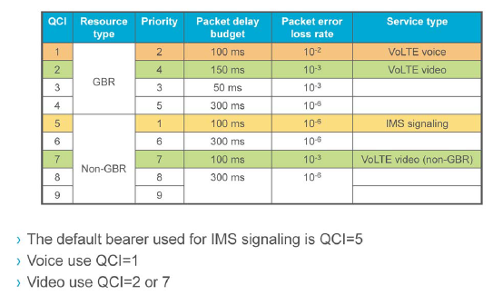
QoS Class Identifier (QCI)

Slide 15
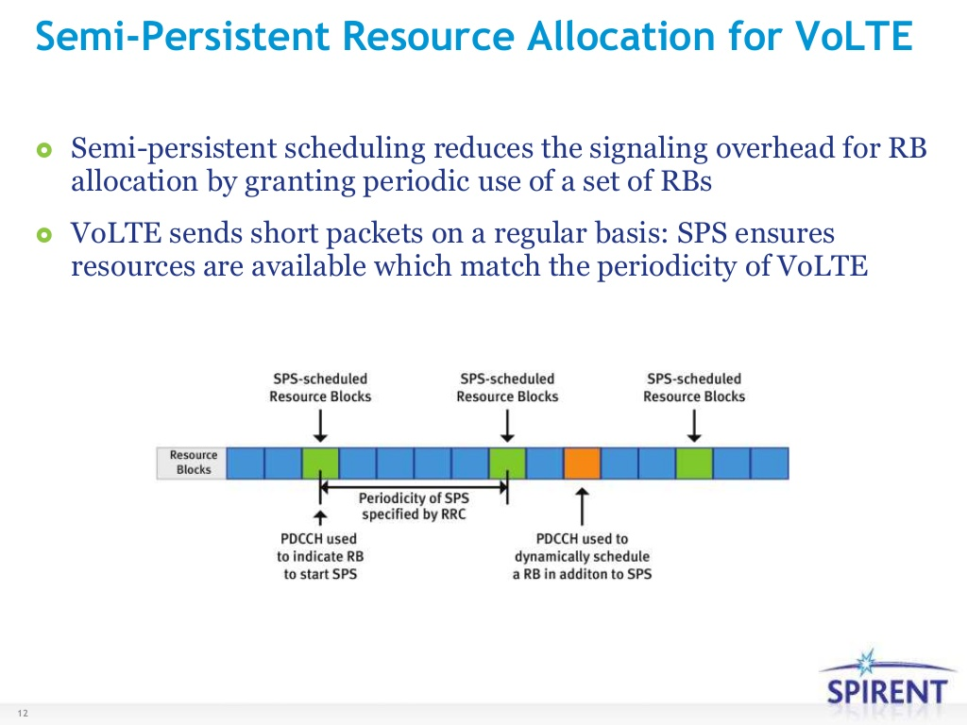

Slide 16
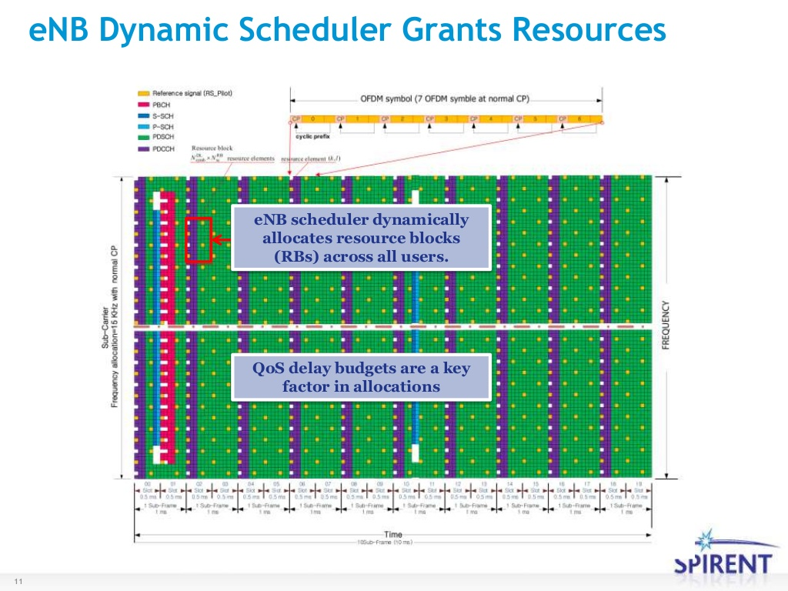

Slide 17
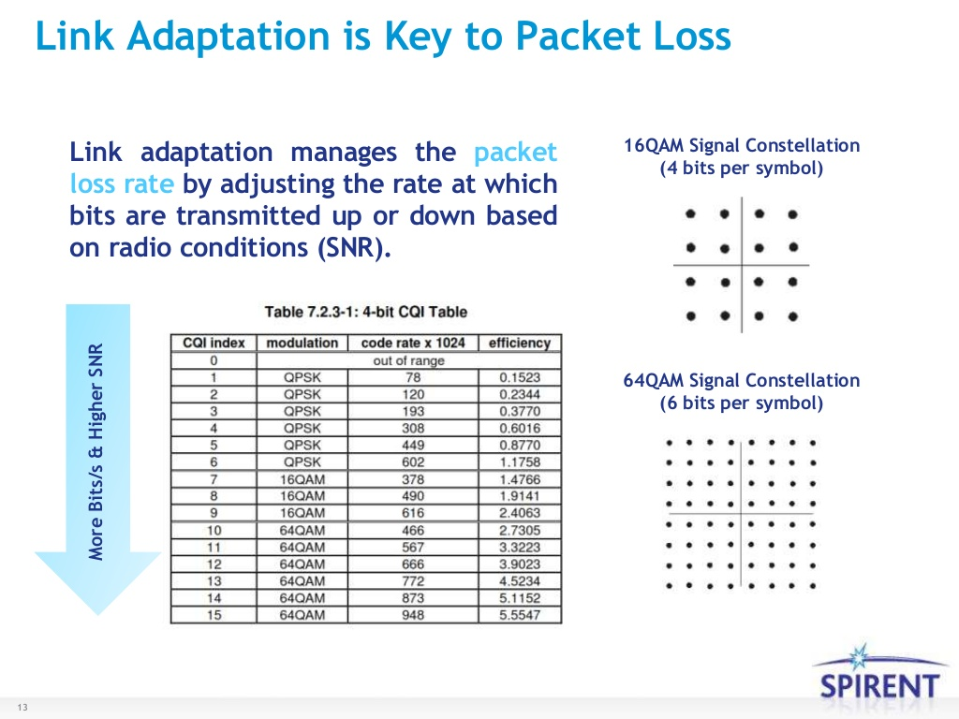

Slide 18
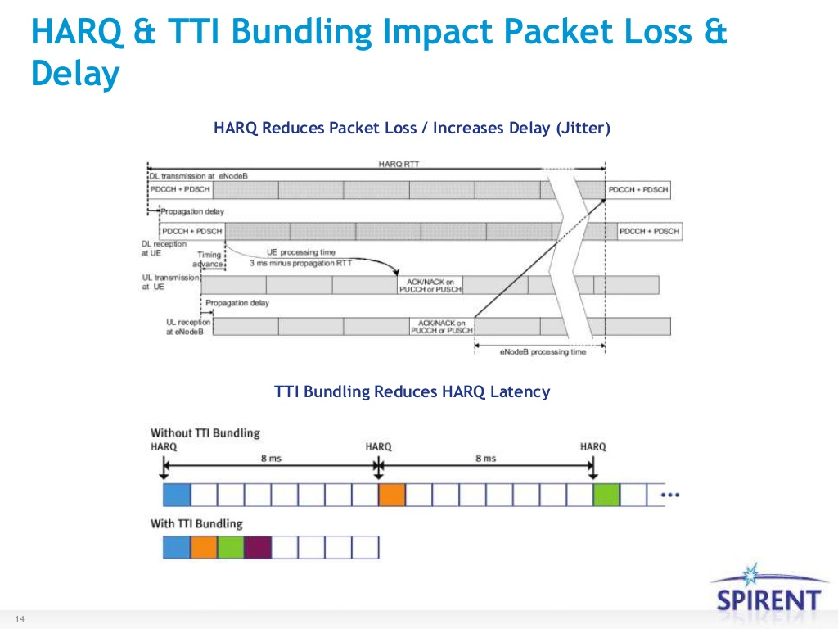

Slide 19
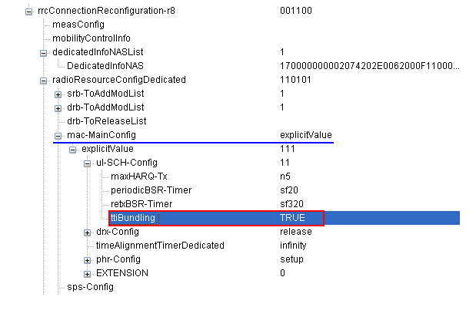
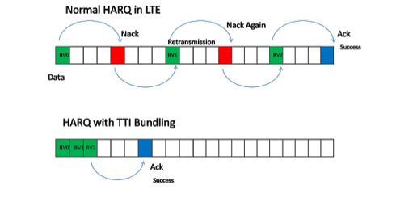
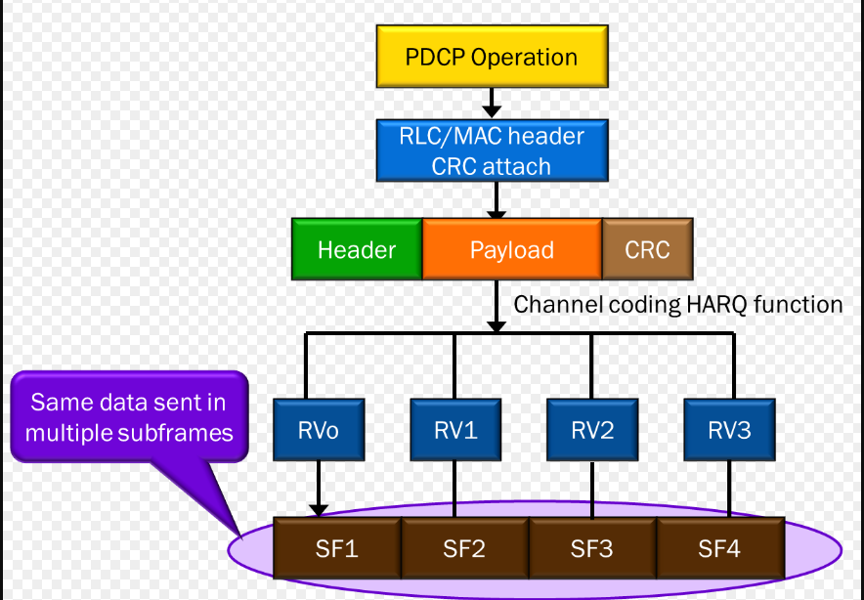
TTI Bundling
TTI Bundling optimizes the uplink (cell edge) coverage for services like VoLTE. For services such as VoIP, the packet size is small and the inter-arrival time of VoIP packets is constant (i.e., AMR codec provides one packet every 20ms during active period and one silence indicator (SID) at 160ms). In a cell edge scenario, the probability of decoding PUSCH as error is more so instead of waiting for HARQ feedback from eNB, the UE performs initial transmission and re-transmissions in 4 consecutive Transmit Time Intervals (TTIs)
Once TTI Bundling is enabled/activated the UE send the same packet but with different error detection and correction bits in 4 consecutive TTIs
TTI Bundling reduces a lot of signalling overhead as the eNB doesn’t need to send Ack/Nack for every (re-) transmission instead it sends Ack/Nack for the entire bundle
Latency is also reduced as no waiting time (for HARQ feedback) is required between the re-transmissions

Slide 20
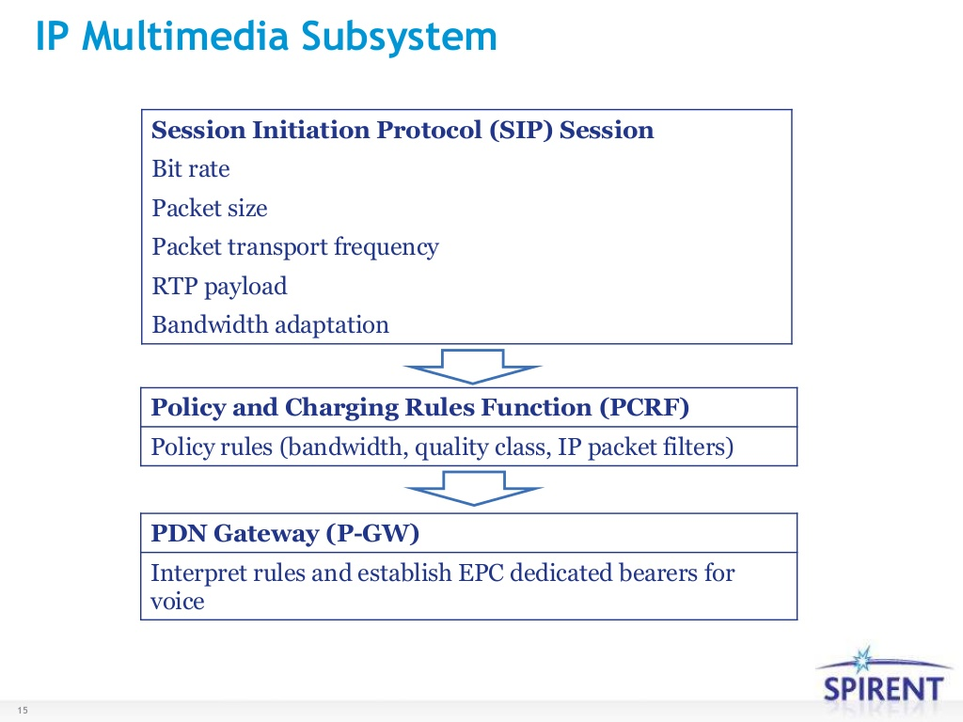

Slide 21
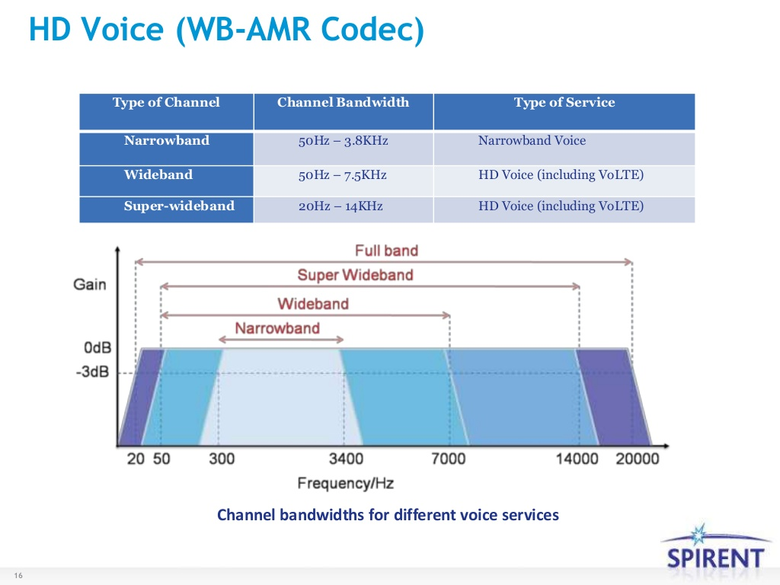

Slide 22
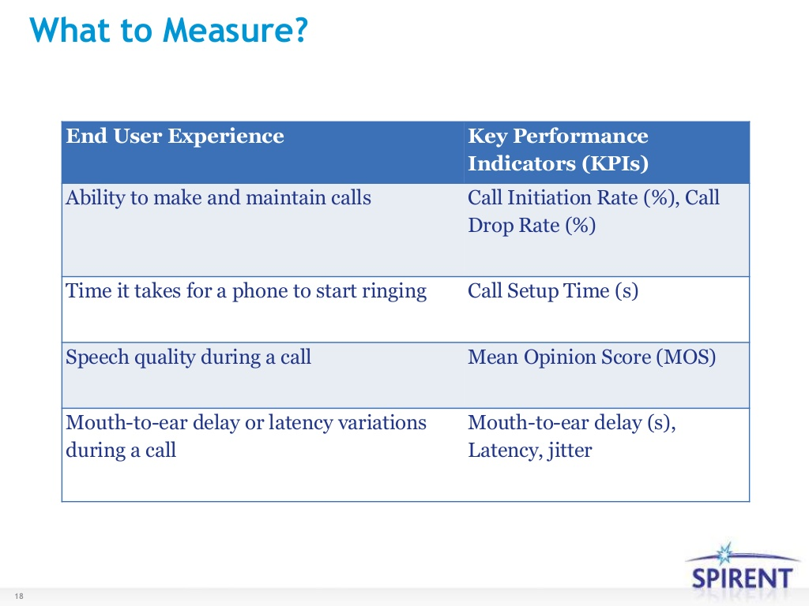

Slide 23
UE Characteristic
User Equipment (UE)
User Equipment (UE) is the mobile terminal which may be a smartphone or tablet or any communication device. An IMS powered UE has two main components.
Universal Integrated Circuit Card (UICC)
Session Initiation Protocol User Agent (SIP UA)
Universal Integrated Circuit (UICC)
Each UE must contain one UICC and each UICC may have one or more of the following modules.
Subscriber Identity Module (SIM): SIM identity information used by a GSM network.
UMTS Subscriber Identity Module (USIM): USIM information used by a UMTS or LTE network.
CDMA Subscriber Identity Module (CSIM) or Re-Useable Identification Module (R-UIM): identity information used by a CDMA network.
IP Multimedia Services Identity Module (ISIM): ISIM identity information used by the IMS subsystem.
Let’s look into ISIM which is important when UE wants to use IMS resources in the network. ISIM contains the following:
IP Multimedia Private Identity (IMPI): IMPI is a global identity allocated by home network. IMPI contains home operator’s domain information.Home operator’s domain name
IP Multimedia Public Identity (IMPU): IMPU acts like a telephone number which can either be a SIP URI (sip:<username>@<host>:<port>) or a tel URI (tel:<country_code><national_destination_code><subscriber_number>).
Secret Key: This long secret key is used for user authentication and SIP registration.
SIP User Agent (SIP-UA)
SIP User Agent resides in the UE to transmit and receive SIP messages. SIP-UA provides basic telephony functionality. It can act in two different roles:
User Agent Client (UAC): As a client to send SIP request
User Agent Server (UAS): As a server to receive requests and send response

Slide 24
EPC
Evolved Packet Core (EPC)
For VoLTE and IMS prospective two nodes are important in the Evolved Packet Core.
Public Data Network Gateway (PDN-GW)
PDN Gateway is responsible for allocating IP addresses to UEs. PDN-GW is also the point of communication between EUTRA and non-3GPP services like internet.
When IMS is used there can be more that one PDN-GW in the EPC one for internet and one for IMS.
Policy and Charging Rule Function (PCRF)
The PCRF provides real-time determination of what types of traffic are allowed under what conditions, and also determines how to account for this traffic (for billing purposes). Based on requests for IMS services, the PCRF also initiates the appropriate bearers.
When a user initiate a VoLTE call PCRF checks if that user is allowed to start a VoLTE call or not and if it is allowed PCRF set up dedicated bearer.

Slide 25
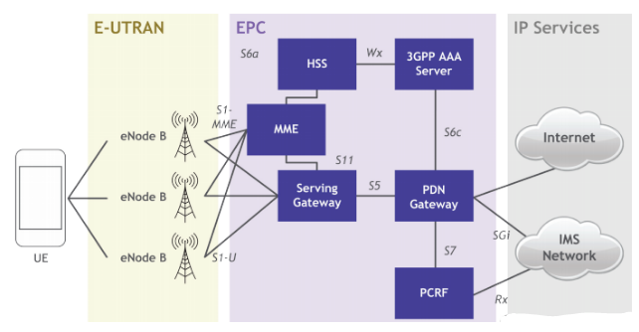
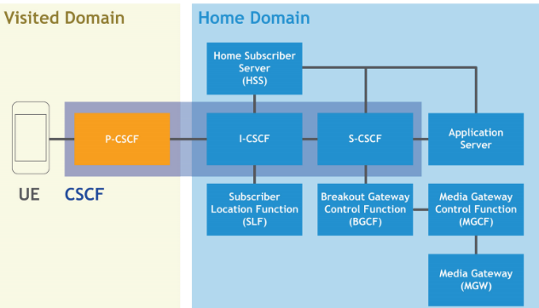
VoLTE Architecture
IMS Architecture

Slide 26
Policy Management for VoLTE
VoLTE Service is dramatically increasing the number of transactions to be processed by Policy Management.
Service Providers require very high performing Policy Management system and most importantly a solution able to scale in a very cost efficient way involving linear scalability, virtualization, N+1 redundancy, etc.
VoLTE requires a very low latency figure (order of 10 ms) in comparison with the latency for Data Services (order of 100 ms). Service Providers require then Policy Management solution able to handle Diameter transactions in a very fast mode even at high TPS (transaction per second) rate.
VoLTE requires a fundamental functionality, session correlation i.e. the ability at the Policy Management node to associate a Diameter request from the IMS domain to a Diameter session from the EPC domain. This functionality becomes more and more complex as service providers scale their policy management solutions.
Biggest complexity resides in the fact that all these requirements have to be met at the same time by Policy Management solutions.
Fortunately, Data Services and VoLTE Service allow a clean separation in the network for Policy Management. As a consequence, Service Providers can maintain their existing Policy Management solutions for Data Services and deploy a Policy Management solution specifically for VoLTE. As previously discussed, a Policy Management solution able to meet all those requirements and helping Service Providers solve the challenges introduced by VoLTE.

Slide 27
IMS Network
Call Session Control Function (CSCF)
CSCF is responsible for establishing, monitoring, supporting and releasing multimedia sessions. It has three different functional elements which may or may not be separate physical entities.
Proxy CSCF: P-CSCF is seen as the initial point of contact from any SIP User Agent. It handles all requests from the UE and is, from the UE’s point of view, the “SIP proxy” to the entire subsystem.
Serving CSCF: S-CSCF has knowledge about the user and what applications are available to the user. It acts as a decision point and it’s main job is to decide whether or not the user’s SIP messages will be forwarded to the application servers.
Interrogating CSCF: I-CSCF is the entity that initiates the assignment of a user to an S-CSCF (by querying the HSS) during registration.
Home Subscriber Server (HSS)
HSS is a database that maintains user profile and location information and is responsible for name/address resolution. HSS is also responsible for authentication and authorization.
Subscriber Location Function (SLF)
SLF is responsible for assigning HSS to user in home network. To achieve this function SLF keeps track of all HSSes.
Media Gateways
Media Gateway resides at the inteface between SIP based IMS network and traditional PSTN network. More details are found in RFC 3372 (Session Initiation Protocol for Telephones (SIP-T): Context and Architectures)
Media Gateway Control Function(MGCF)
Media Gateway Control Function controls media gateways, converts codecs where necessary and may serve as a breakout to a circuit-switched network.
In the case when MGCF works as a breakout to CS network it is also responsible for managing the conversion of signaling messages, converting SIP messaging to the Bearer Independent Call Control (BICC) and ISDN User Part (ISUP) protocols used in legacy systems.
Breakout Gateway Control Function (BGCF)
When Media Gateway Control Function does not include breakout to circuit-switched network, BGCF takes care of this functionality.

Slide 28
SIP CODE
SIP Responses are maintained in an IANA list called Session Initiation Protocol (SIP) Parameters. They always begin with a Response Code, which falls into one of the following categories:
Informational/Provisional (1xx): Request received and being processed – Examples: 100 Trying, 180 Ringing
Successful (2xx): The action was successfully received, understood, and accepted – Examples: 200 OK, 202 Accepted
Redirection (3xx): Further action needs to be taken (typically by the sender) to complete the request – Examples: 301 Moved Permanently, 302 Moved Temporarily
Client Failure (4xx): The request contains bad syntax or cannot be fulfilled at the server – Examples: 401 Unauthorized, 403 Forbidden
Server Failure (5xx): The server failed to fulfill an apparently valid request – Examples: 500 Server Internal Error, 504 Server Time-out
Global Failure (6xx): The request cannot be fulfilled at any server – Examples: 600 Busy Everywhere, 604 Does Not Exist Anywhere

Slide 29
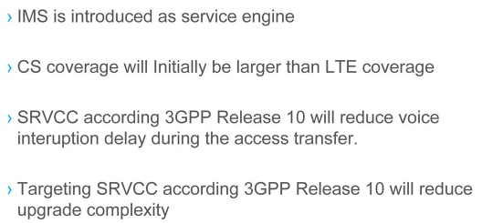
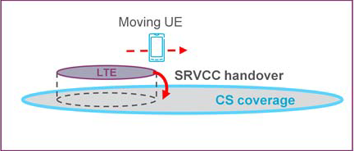
SRVCC- Single Radio Voice Call Continuity
The SRVCC Handover to UTRAN feature is very similar to the Coverage-Triggered WCDMA IRAT Handover feature, but with the main difference that when the handover procedure is started, an indication is included that Single Radio Voice Call Continuity (SRVCC) should be used.
The indication on the use of SRVCC tells the Mobility Management Entity (MME) that the UE voice bearers must be transferred to the CS domain in the target cell. In addition, when deciding on what target cell to choose for the SRVCC handover, an explicit check is made on whether the cell is SRVCC capable.
The following must be fulfilled at feature activation:
The features that will trigger an SRVCC Handover must be activated and configured correctly.
There must be UE in the network that have the capability to do SRVCC Handover to WCDMA/CDMA. This is indicated in the Feature Group Indicator (FGI) bit 27, see 3GPP TS 36.331.
The core network (MME) that handles the eNodeB where the UE is connected must support SRVCC. This is indicated in the SRVCC operation possible information element in the INITIAL CONTEXT SETUP REQUEST S1 message or in the HANDOVER REQUEST S1/X2 message described in 3GPP TS 36.413 and 3GPP TS 36.423.
In addition, some neighbor WCDMA system must support the SRVCC procedure.

Slide 30
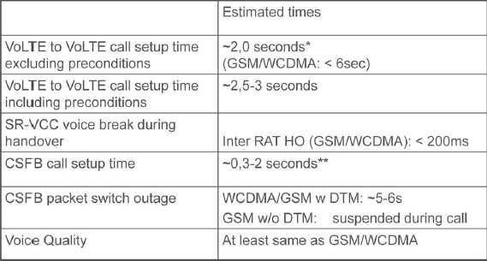
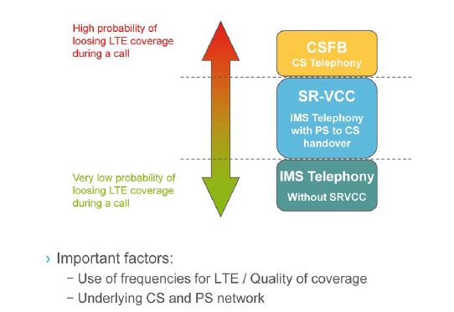
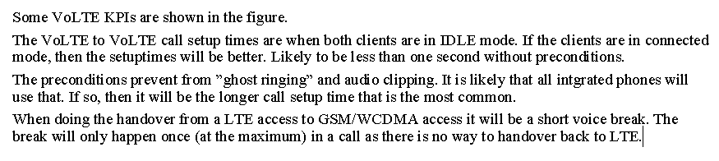
SRVCC - Single Radio Voice Call Continuity

Slide 31
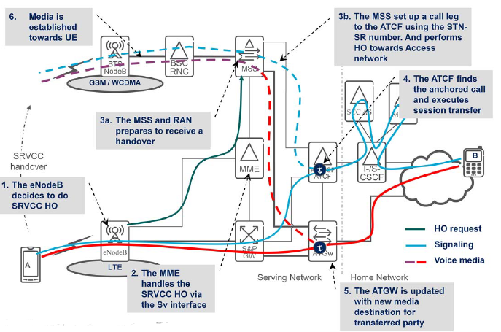
SRVCC Flow Chart
eNodeB Decides SRVCC HO based on Measurement
2. MME handle SRVCC HO via Sv Interface
3a. MSC and RAN prepare to receive a HO
3b.MSC setup a call to ATCF using Session Transfer Number(STN) for SRVCC and perform HO towards CS Access network
4.ATCF finds the anchored call and executes session transfer
5. ATGw is updated with new media destination for transferred party
6. Media is re-established over CS-access towards the UE

Slide 32
SRVCC - Parameters
Model | MO Class Name | Parameter Name | Parameter Description | Range and Values | Default Value | MultiplicationFactor | Unit
ENodeBFunction | EUtranCellFDD | pdcchOuterLoopInitialAdjVolte | The initial value for PDCCH outer loop adjustment for UEs with any bearer mapped to a QCI with serviceType of VoIP. | -200..200 | -70 | 0.1 | dB
ENodeBFunction | EUtranCellFDD | pdcchOuterLoopUpStepVolte | PDCCH outer loop up step size for UEs with any bearer mapped to a QCI with serviceType of VoIP. | 0..100 | 6 | 0.001 | dB
ENodeBFunction | EUtranCellFDD | pdcchTargetBlerVolte | PDCCH target error rate for UEs with any bearer mapped to a QCI with serviceType of VoIP. | 1..200 | 22 | 0.05 | %
ENodeBFunction | AnrFunctionUtran | srvccPolicy | Starting value of the parameter srvccCapability when an ExternalUtranCellFDD/TDD is created by ANR (Automatic Neighbor Relations) | NOT_SUPPORTED CS_ONLY_SUPPORTED PS_AND_CS_SUPPORTED | CS_ONLY_SUPPORTED
ENodeBFunction | ExternalCdma20001xRttCell | srvccCapability | Describes the SRVCC capability of the external cell. | NOT_SUPPORTED CS_ONLY_SUPPORTED PS_AND_CS_SUPPORTED | NOT_SUPPORTED
ENodeBFunction | ExternalUtranCellFDD | srvccCapability | Describes the SRVCC capability of the external cell. | NOT_SUPPORTED CS_ONLY_SUPPORTED PS_AND_CS_SUPPORTED | NOT_SUPPORTED
ENodeBFunction | Cdma20001xRttFreqRelation | voicePrio | This attribute prioritizes CDMA 1xRtt frequencies among all frequencies related to the cell for User Equipments (UEs) in connected mode. It sets the priority value for the frequency to which the mobility action for a voice session is performed. The value -1 means the frequency is excluded. The value 0 means the lowest priority. The value 7 means the highest priority. | -1..7 | 0
ENodeBFunction | UtranCellRelation | CoverageIndicator | Defines whether the coverage areas of the EUTRAN cell and the UTRAN FDD/TDD cell are indicated to overlap (have approximately the same coverage area), or whether the coverage area of the UTRAN FDD/TDD cell is indicated to cover the EUTRAN cell, or if it is contained in the EUTRAN cell. | NONE COVERS OVERLAP CONTAINED_IN | NONE
ENodeBFunction | UtranFreqRelation | mobilityAction | The preferred way to transfer a UE in connected mode to a UTRAN FDD frequency in case of coverage triggered mobility. | RELEASE_WITH_REDIRECT RELEASE_WITH_REDIRECT_NACC HANDOVER | HANDOVER
ENodeBFunction | UtranFreqRelation | mobilityActionCsfb | The preferred way to transfer a UE in connected mode to a UTRAN FDD frequency in case of CS Fallback. | RELEASE_WITH_REDIRECT RELEASE_WITH_REDIRECT_NACC HANDOVER | RELEASE_WITH_REDIRECT
ENodeBFunction | UeMeasControl | allowReleaseQci1 | This attribute specifies whether or not blind and measurement-based Release of a User Equipment (UE) with a QCI1 bearer is allowed. |  | false

Slide 33
SRVCC- Single Radio Voice Call Continuity Feature Operation
If the below criteria holds, an SRVCC handover is possible:
The mobilityAction parameter is set to HANDOVER.
The UE has at least one voice bearer, that is, a bearer with QCI 1.
even if UE has a bearer with a QCI value (other than QCI=1) that correspond to a voice profile, the SRVCC procedure cannot be applied to such a bearer. This is because (in accordance with 3GPP TS 23.216) the core network (MME) is only considering bearers with QCI=1 as voice bearers. Only these will be transferred to the CS domain of the target when the SRVCC procedure is applied for a certain UE.
The UE capabilities says it supports SRVCC.
The MME associated with the UE supports SRVCC.
The selected UTRAN/CDMA cell supports SRVCC.
This is configured in the MOM attribute srvccCapability .
The SRVCC Handover to UTRAN/CDMA feature is OPERABLE.
If, in addition, the below criteria holds, a combined PS and SRVCC handover is possible:
The UE also has at least one bearer with a QCI which is not 1.
The target cell is simultaneously CS and PS handover capable.
This will be the case when the MOM attribute srvccCapability has the value PS_AND_CS_SUPPORTED .
The Coverage-Triggered IRAT Handover feature is OPERABLE.
The eNodeB will never initiate a "release with redirect" for a UE that has voice bearers.
If no appropriate target cell is found where the UE can be handed over, the UE will be kept in the serving cell until new measurement reports are processed and possible new targets for handover can be found.
If no SRVCC feature is enabled, it is possible to override this behavior using the MOM attribute allowReleaseQci1 .

